Slide 1


Intelligent Traffic Signal
Decision System
Design and Simulation Using Combinational Logic Architecture

Slide 2

System Architecture & Sensors
Sensor Array Inputs
Combinational Decision Matrix
Incorporates road-embedded IR and ultrasonic sensors to measure real-time vehicle density across North-South and East-West intersections.
Processes boolean input signals directly through optimized logic gate arrays without micro-controller software delay.
Includes dedicated priority detection lines for emergency vehicles (ambulances, fire engines) to trigger instant preemptive signals.
Generates active high/low logic levels for Red, Yellow, and Green traffic lamps according to deterministic truth table priority rules.

Slide 3


Performance Metrics
Combinational Logic Optimization
75%
By replacing fixed-time sequence controllers with K-Map optimized boolean equations, the system eliminates zero-vehicle green light cycles.
Instantaneous logic gate switching guarantees nanosecond propagation response times for emergency vehicle preemption across all lanes.
Delay Reduction

Slide 4

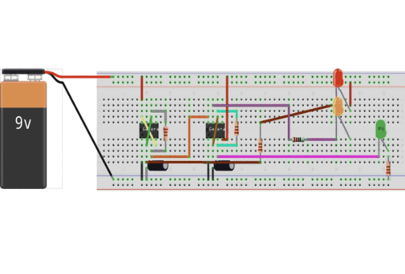
Circuit Simulation & Testing
■
Proteus Simulation: Complete schematic verification proving accurate state switching under varying traffic densities.
■
Gate Optimization: Karnaugh Map reduced Sum-of-Products (SOP) expressions minimize total logic gate count.
■
Emergency Preemption: Emergency override logic instantly overrides standard cycles to force green on active lanes.
■
Hardware Feasibility: Designed with standard 74HC series ICs (AND, OR, NOT gates, Multiplexers) for high reliability.

Slide 5
Questions & Answers
Design and Simulation of an Intelligent Traffic Signal Decision System
Digital Systems Design Lab | Combinational Logic Architecture

